Slide 1

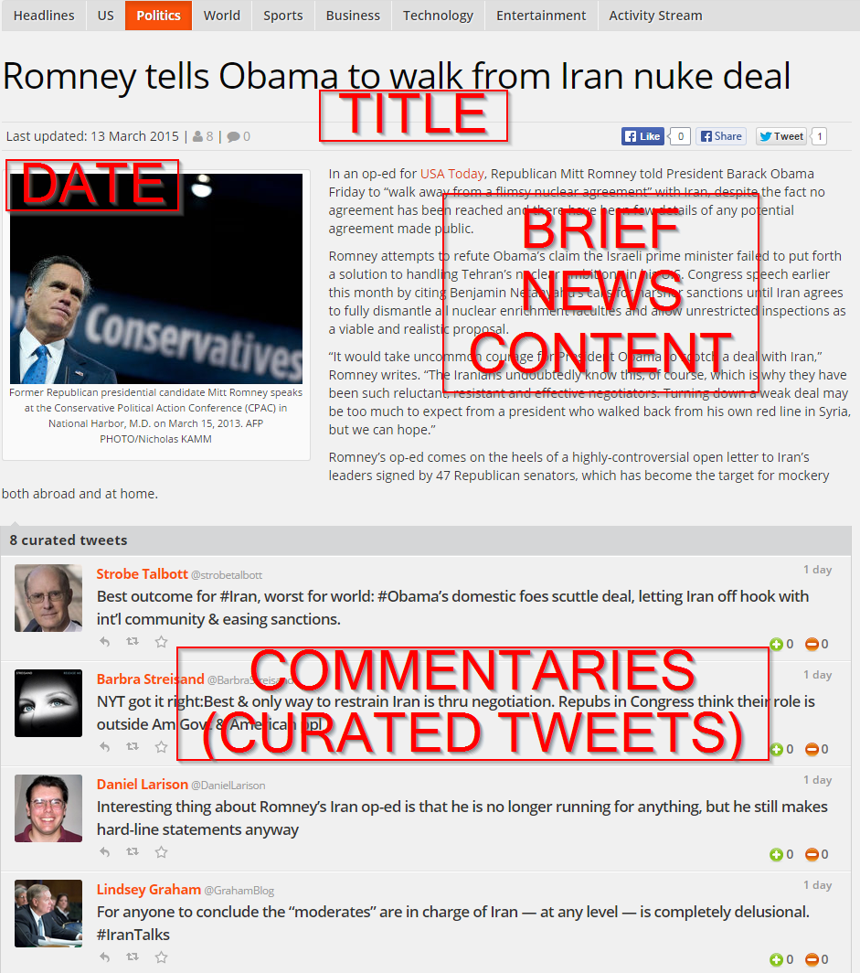
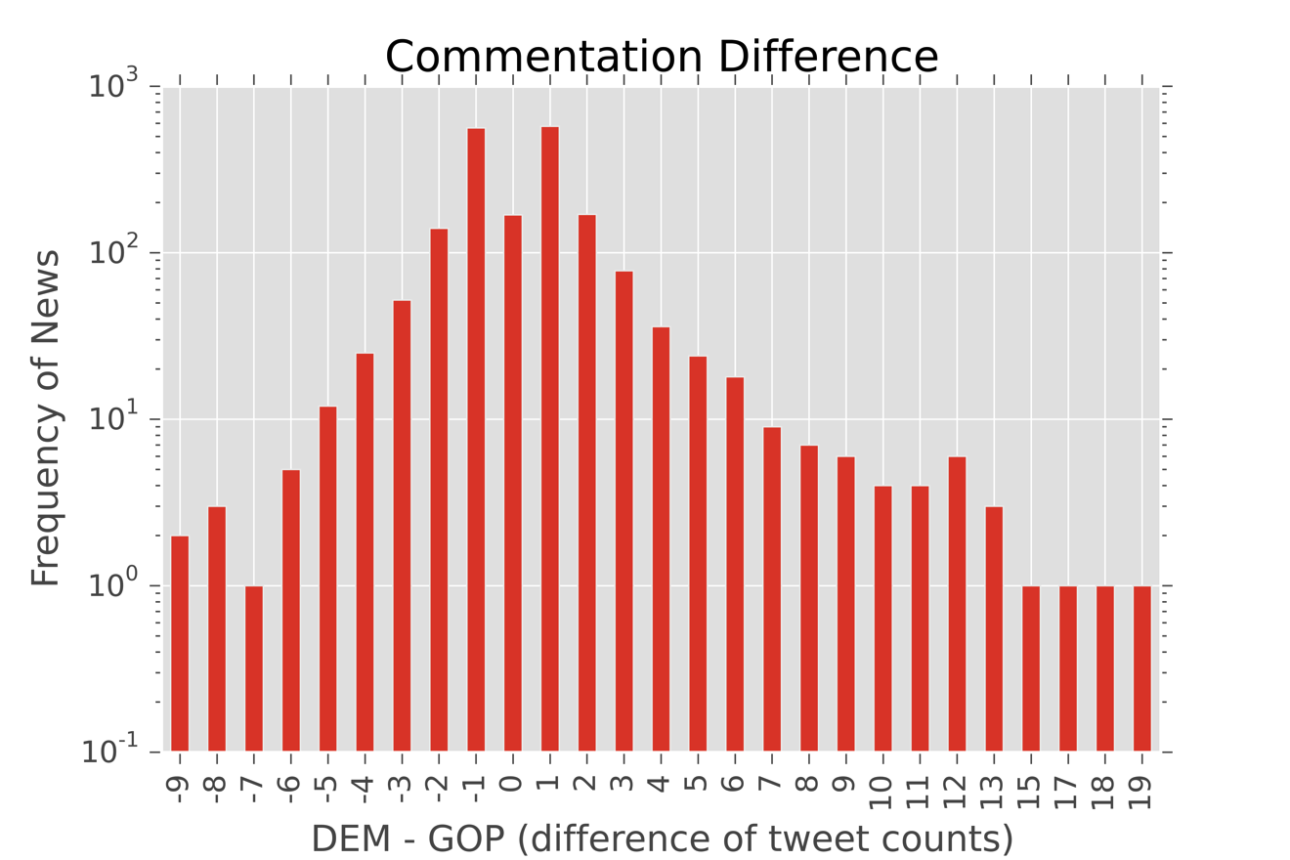
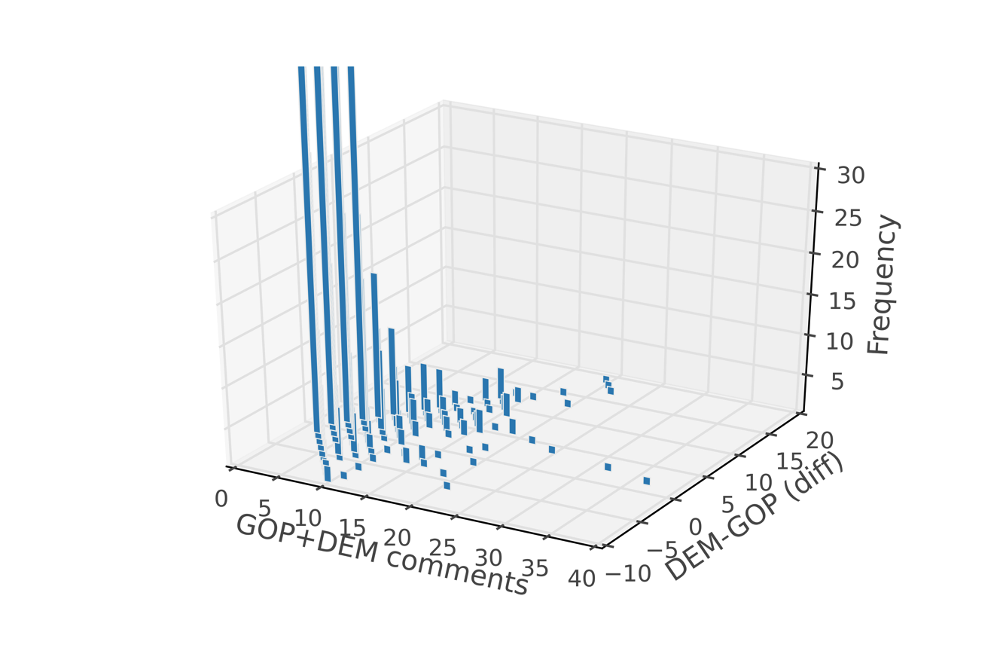
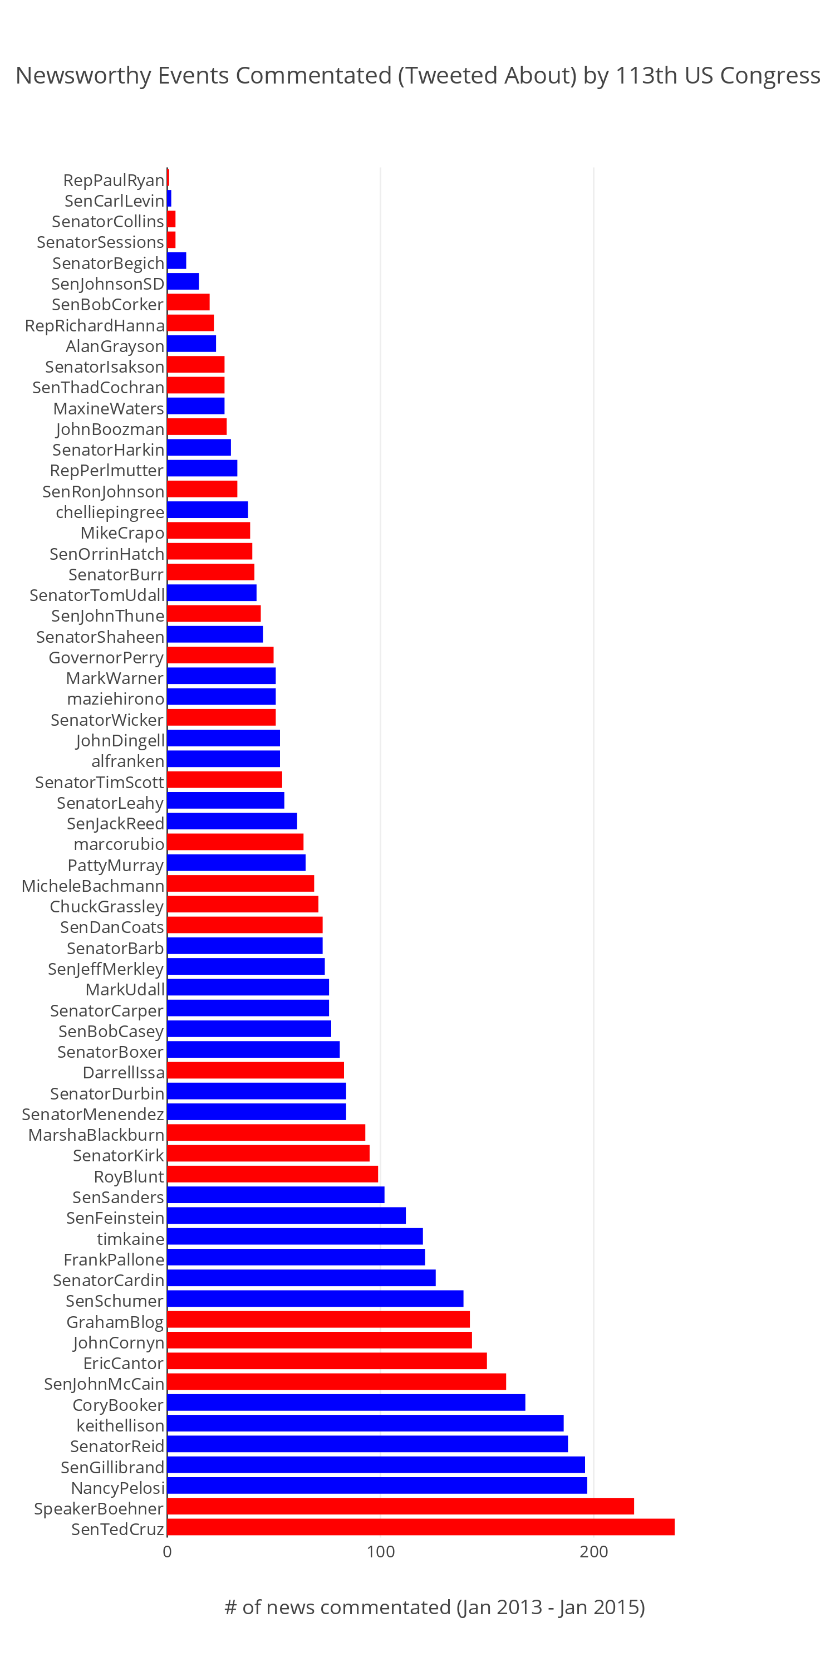
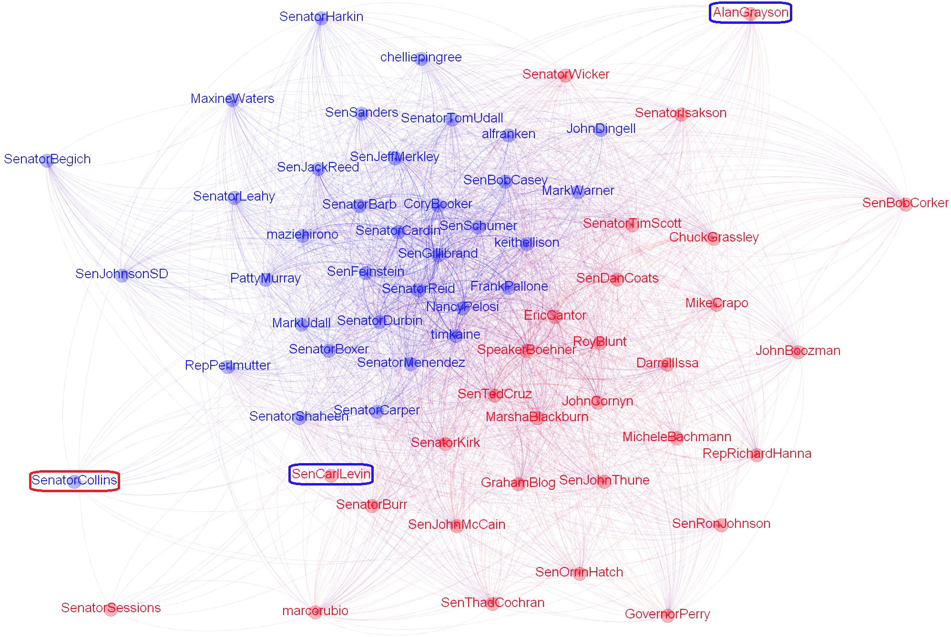


A Study of the 113th Congress as News Commentators on Twitter
Center for Discovery Science and Health Informatics
TALHA OZ, Computational Social Science
George Mason University
RESEARCH QUESTIONS
METHODOLOGY
Is there a positive or a negative correlation between the parties’ comment amounts on news events? And what events have been the most distinctive for the groups in the 113th Congress?
Do the Members of Congress (MCs) use social media as a channel for agenda-building?
The entire ThePlazz website is scraped and the dataset is prepared.
Members of 113th Congress (MCs) are identified and filtered using several public Twitter lists.
For each event (news article), comments of the MCs are grouped by their parties.
Charts plotted to show the parties’ commentation patterns on the events, and Pearson correlation coefficient is calculated on the numbers of comments made per event by each party.
Comment differences are calculated per event at party level.
Two networks (one-mode and two-mode) are created. In the two-mode network, events are the events that have made to the headlines and the actors are the MCs. One-mode network edges are weighted by the number of events on which both of the incident MCs have commentated.
An exponential random graph model (ERGM) is attempted to fit to measure the effect of being in the same group on the tie formation in the two-mode network.
Community detection algorithm is employed on the one-mode network and visualized by Gephi and algorithmically identified groups are compared with the actual groups of the congressional members.
DATASETS
The main dataset used in this study is created by scraping ThePlazz.com news media site and made available online. ThePlazz dataset consists of 7,376 headlines (with a few paragraphs-long news content) published between January 2013 and January 2015 on theplazz.com news site, as well as 156,480 “newsworthy” commentary tweets of 1,442 “newsmakers and opinion shapers” on these news events. All the tweets are curated manually by ThePlazz editors. Among the monitored tweeps, 65 are congressional members (44 of which are Senators) and all of their curated tweets (4,937) on 1,916 headlines are included in this study.
Interpretation of the Charts (RQ#1)
The chart on the left shows the distribution of the comment count differences of the parties (|D-R|) on the events. As the log-scaled y-axis suggests the difference is minor (less than 2) on most of the events. And in these cases, as plotted in the 3-D chart on the right, most of the time the total (D+R) number of the comments on an event is no more than 5.
RESULTS
Title | Date | D - R
Republicans call Obama executive action illegal | 11/20/14 | -9
Tweeps wish US’ 40th prez a happy birthday | 2/6/14 | -9
Sign up trouble? WH extends deadline again | 3/25/14 | -8
Britain’s Iron Lady dies of stroke at 87 | 4/8/13 | -8
Late filers beware: The taxman cometh | 4/15/14 | -8
SCOTUS rules for prayer at public meetings | 5/5/14 | -7
National Day of Prayer offers controversy, unity | 5/1/14 | -6
GOP calls for ‘permanent delay’ of ObamaCare | 7/10/13 | -6
WH may not cooperate with Benghazi probe | 5/5/14 | -6
Repubs squelch short-term budget fix | 2/5/13 | -6
Shinseki resigns from VA following apology | 5/30/14 | -6
Boehner pressed for Obamacare alternative | 12/3/13 | -5
Sudan detains Christian woman after release | 6/24/14 | -5
214 days later: Mexican court frees Tahmooressi | 11/1/14 | -5
Obama extends to 2016 ACA employer mandate | 2/10/14 | -5
Obamacare head steps down from HHS | 4/10/14 | -5
Vets at WWII Memorial become props in dispute | 10/2/13 | -5
SCOTUS curbs Obama’s recess appointments | 6/26/14 | -5
After IG report, calls for Shinseki to resign | 5/28/14 | -5
A Presidential icon, now gone for a decade | 6/5/14 | -5
CBO: O’care kills equivalent of 2M jobs | 2/4/14 | -5
House holds Lerner in contempt of Congress | 5/7/14 | -5
March for Life continues despite cold weather | 1/22/14 | -5
House Republicans push Benghazi committee | 5/8/14 | -4
Obamacare’s employer mandates delayed | 7/2/13 | -4
GOP to form special Benghazi committee | 5/2/14 | -4
Thousands gather on Washington Mall | 2/17/13 | -4
Will beheadings become call to action for Obama? | 9/2/14 | -4
O’care figures frustrate pro’bama fact checkers | 2/24/14 | -4
IRS to investigators: Can’t find Lerner’s emails | 6/13/14 | -4
 |  | ..
Gun control in focus 2 years after Sandy Hook | 12/14/14 | 8
Senate advances bill to extend jobless aid | 1/7/14 | 8
SOTU puts spotlight on min. wage, gender gap | 1/29/14 | 8
Obama to governors: ‘sequester hurts states’ | 2/25/13 | 9
Paycheck Fairness Act voted down by GOP | 4/9/14 | 9
Secret US-China climate agreement unveiled | 11/12/14 | 9
Senate’s unemployment bill defeated by 1 vote | 2/6/14 | 9
Exec. order ends federal LGBT job discrimination | 7/21/14 | 9
Politicos, businesses thank teachers, nurses | 5/6/14 | 9
Sundown ushers in the Jewish New Year | 9/24/14 | 10
LGBT non-discrimination act clears Senate hurdle | 11/4/13 | 10
Nobel Peace Prize goes to child rights activists | 10/10/14 | 10
World AIDS Day to raise awareness, funds | 12/1/14 | 10
Obama to tackle LGBT job discrimination | 6/16/14 | 11
Military sexual assault bill rejected by Senate | 3/6/14 | 11
ENDA clears first hurdle, Senate votes 64-32 | 11/7/13 | 11
#WomensEqualityDay marks suffrage anniv. | 8/26/14 | 11
Renowned poet, author Maya Angelou dies | 5/28/14 | 12
‘Not My Boss’ Business Act’ shot down in Senate | 7/16/14 | 12
College affordability makes Dem agenda | 5/5/14 | 12
SCOTUS rules in favor of Hobby Lobby | 6/30/14 | 12
The Civil Rights Act of 1964 turns 50 | 7/2/14 | 12
SCOTUS ends overall campaign donor limits | 4/2/14 | 12
Deportation to focus on ‘felons not families’ | 11/20/14 | 13
Earth Day observers consider climate change | 4/21/14 | 13
Dems tweet support for ‘Not My Boss’ Business’ | 7/14/14 | 13
Dems host climate-change talk-a-thon | 3/10/14 | 15
Senate passes 5-month UI extension | 4/7/14 | 17
Dems’ attempt to raise minimum wage fails | 4/30/14 | 18
Dems push #EqualPay bill on Equal Pay Day | 4/8/14 | 19
Regarding to RQ#1, it is found out that there is a positive correlation between the number of commentations per event (R=0.24***) made by each party, i.e. most of the time members of the both parties are likely to commentate on the same events about the same amount. Meanwhile, although rare, there are some events that only members of one party are willing to commentate on. Extreme values of the differences on the comments reveal the events that members of one party like to talk much more than the other. (Appears to a better measure than the likelihood ratio, for this sample distribution)
Although, the findings regarding to RQ#1 might be discouraging in terms of observing agenda-building efforts of MCs on social media; using social network analysis approach, 95% of the MCs are found to be in the same group as their co-party members (see the network below). Without looking at the context of the events or tweets, but just using who commentates (tweets) with whom (on the same event) network, we could be able to identify the actual groups of the MCs. As this finding can be explained by the homophily effect, it can also be considered as a result of agenda-building efforts of MCs.
Screenshot of a news headline on ThePlazz news site; Newsmakers’ tweets related to the events are placed underneath the news article
Node colors represent the groups identified by the community detection algorithm. The three MCs in the rectangles are the ones whose groups are misidentified. Regarding to them, although Sen. Collins is a Republican, she is listed as a Democrat in an ideology scores list¹ as well. Sen. Levin was the Chairman of the Armed Services committee, so commented on related issues which is “owned” by the Republicans.
Column 1 is the title of the news article published by ThePlazz website to cover the event. the 2nd column is the date of the news published. The 3rd column shows the difference of the group members (MCs) commentated on the event.
References
W. Russell Neuman et al., “The Dynamics of Public Attention: Agenda-Setting Theory Meets Big Data,” Journal of Communication 64, no. 2 (April 1, 2014): 193–214, doi:10.1111/jcom.12088.
David R. Hunter et al., “Ergm: A Package to Fit, Simulate and Diagnose Exponential-Family Models for Networks,” Journal of Statistical Software 24, no. 3 (2008): 1–29.
Bastian, Mathieu, Sebastien Heymann, and Mathieu Jacomy. "Gephi: an open source software for exploring and manipulating networks." ICWSM 8 (2009): 361-362.
¹ https://www.govtrack.us/congress/members/report-cards/2013/senate/ideology
Machine Learning and Inference Laboratory
College of Health and Human Services
http://talhaoz.com/news
4400 University Dr. MSN 1J3
Fairfax, VA 22030 USA

